Slide 1
Medical Image Analysis (MIA)
Martin Urschler
KU Sheet 1

Slide 2
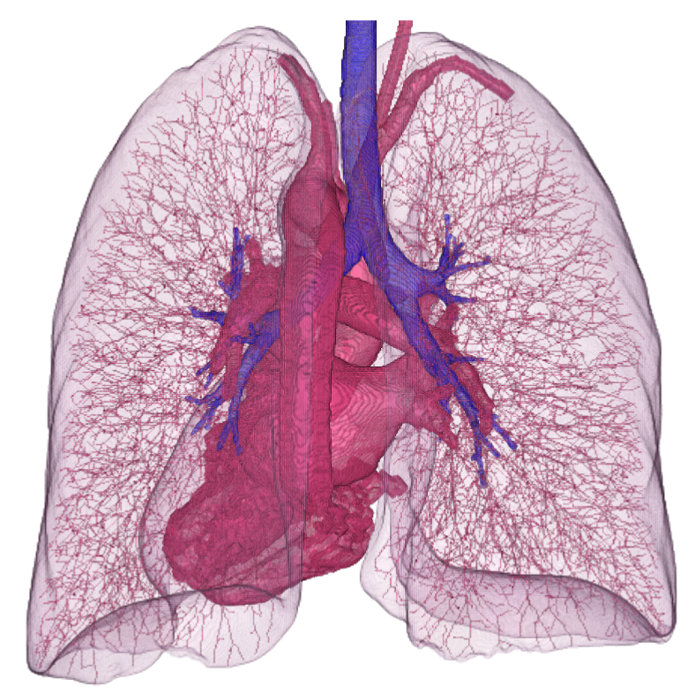
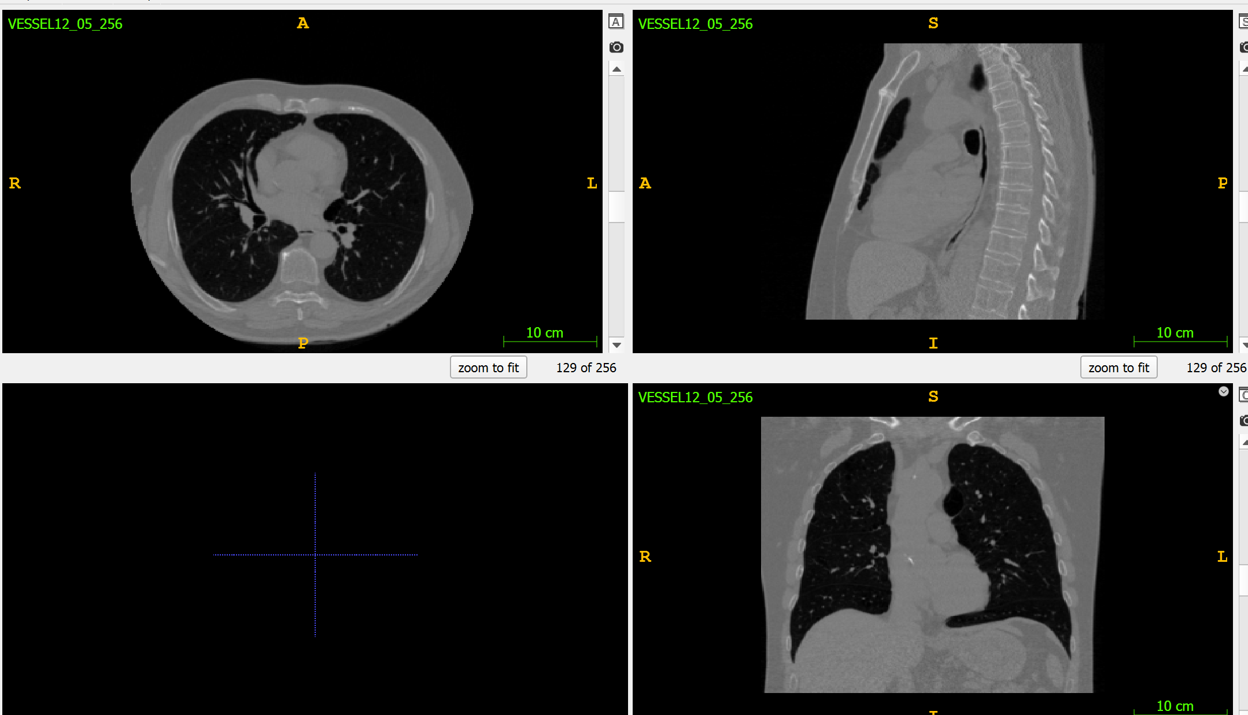
KU Exercise
Our overall aim for the KU is to extract the lung and pulmonary vessel structures from a 3D CT volume
3D CT volume in MetaImage (mhd) format

Slide 3
KU Organization
Software: Python or C++ (each team can choose)
Python is the preferred language, since it is simpler to program
However, in C++ it is easier to get the code to run fast!
There is a simple Python template code in the github repository with the material
If you want to work with C++, please get in touch with me, and I will provide some extra code and information
KU related questions can be asked after our block lectures, or by EMail
If there is interest, I may consider to schedule a weekly office hour (which I could already start in the first week of January, if required)
Of course, plagiarism is not allowed and will be checked!

Slide 4
KU Organization
The KU will be organized in groups of 2 students, please form teams
There will be 2 sheets of tasks, first we will perform a lung segmentation (this sheet), and later we will do the enhancement of the vascular structures (Sheet 2)
For each sheet, the group hands in the source code and a written PDF document (word or anything else than pdf will not be assessed!)
Content of PDF:
Task Description (keep it short, just enough to give a reader some context, you may want to refer to lecture notes)
Input and Output Images (if applicable), if you tried it on additional images that you find on the web, describe those!
Description of the algorithms (again keep it restricted, but give an overview what you implemented)
The outcome of the required experiments, what did you learn?

Slide 5
KU Organization
Hand in is via github. Use a github repository with all your code, datasets and the pdf report and send me the git URL via EMail on the due date. I will clone it and use it for assessment as is. Note that your code has to run out of the box (including Python dependencies in the requirements.txt file, if you have additional ones!). I do not want to spend time to get your code running!
The hand in date for Sheet 1 is: Wednesday, 18.01.2023, 23:59
You can download Python template code and the CT volume from this public (but read only) github repository: https://github.com/martinurschler/MIA2022_KU_Template
You may want to clone it, and then push your changes to your own repository
Use Github Issues for comments, requests or if you find a bug

Slide 6
KU Organization
We use Python and the ITK toolkit via the SimpleITK package
If you want to use C++ instead, have a look at the cmake system www.cmake.org for creating platform independent makefiles, and you also have to install ITK from www.itk.org
ITK is a powerful library for image segmentation, processing and registration, written itself in C++, but providing Python wrappers (e.g. SimpleITK)
Have a look at the documentation for SimpleITK first (https://simpleitk.org)

Slide 7
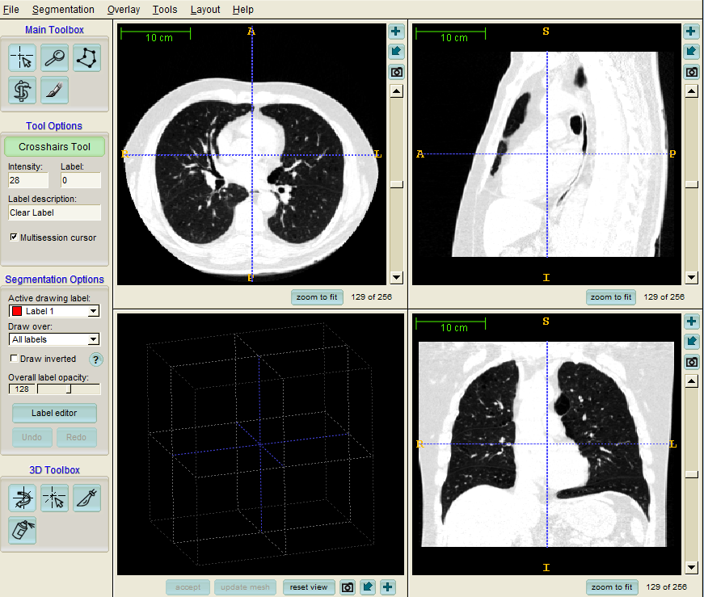
KU Organization
Another important tool to use is ITK-Snap for visualizing 3D volumes
You can use other tools as well, but this one is simple to learn and comes from the developers of ITK
Install ITK-Snap from www.itksnap.org
You can open our sample CT volume (see path ‘data’ in code template) and inspect axial, sagittal and coronal views of the 3D volume
Important: Study ‘Image Information’ and ‘Image Contrast’ under ‘Tools’, the latter can be used for different greyvalue mappings to focus on vessels, soft tissue or bones (Short- cut ‘Ctrl-I’)

Slide 8
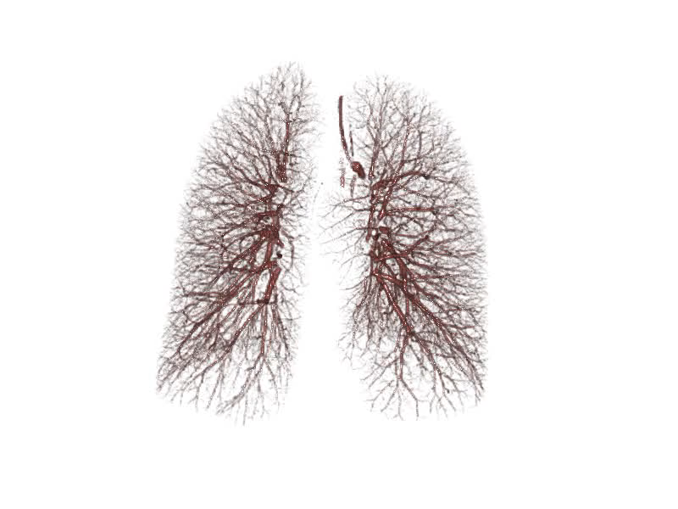
KU Sheet 1
Our aim is to enhance vessel structures
Our first task is to restrict computation of vessel structures solely to the lung!
So we need a lung segmentation!
Video

Slide 9
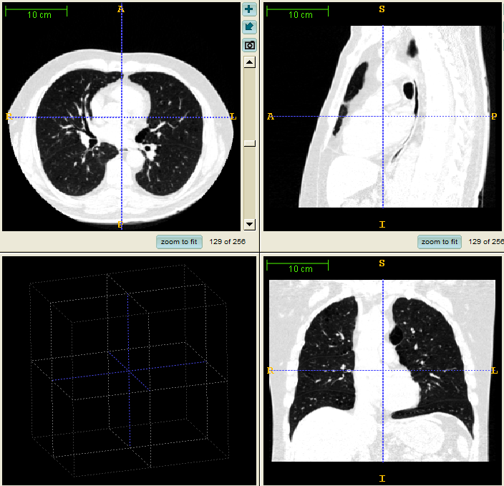

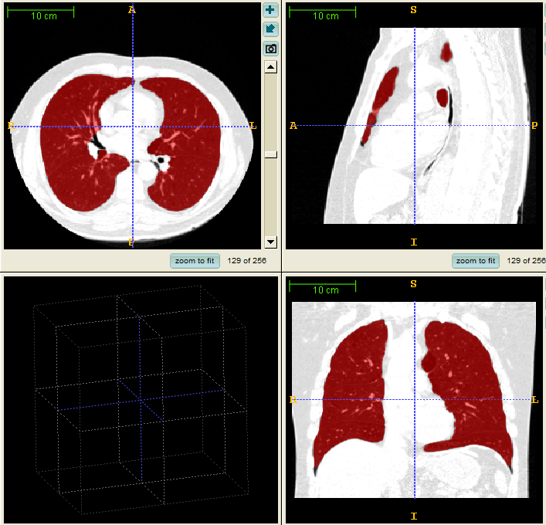
KU Sheet 1
Goal: Lung Mask Extraction from CT Volumes Using our ROF Denoising from the Lecture
Our input volume is called ‘VESSEL12_05_256.mhd’ and is stored in MetaImage format (the volumetric image format defined by ITK), it has a size of 256x256x256
Input
Denoised
Lung Mask

Slide 10
KU Sheet 1
ROF Denoising removes small lung details, i.e. vessels, the large remaining dark structure is the lung
Read the input volume with the sitk ReadImageFilter (see code template)
Convert the input volume (a 16 bit integer with values between ca. -1000 and +1000, representing Hounsfield Units) to a float volume scaled between 0.0 and 1.0
Implement the ROF primal-dual algorithm from the lecture
Use simpler timesteps than the scheme described by Zhu and Chan: tau_p = 0.02 and tau_d = 2.0
Use a lambda (weighting data fidelity term and regularization term) in the range between 0.1 and 10.0, perform experiments studying the effect of several of these different lambdas!
The nrIterations can be fixed to a few 100, e.g. 300 to 500. You may want to study the effect of the number of iterations to get a feeling when to stop (or optionally think about a convergence check!)

Slide 11
KU Sheet 1
After ROF Denoising:
Apply an Otsu Threshold (ITK filter) to get dark regions, 128 bins are a reasonable bin size for the histogram
Use Shape Labeling (i.e. Connected Component Analysis) to find the connected components in the thresholded segmentation image
Choose the lung according to labeled shape sizes (the background is the largest dark region)
Optionally: Refine the lung segmentation by region growing with the ITK, to fill some gaps near the diaphragm for example (don’t forget to describe it in your report). For full marks, the region growing is required!

Slide 12
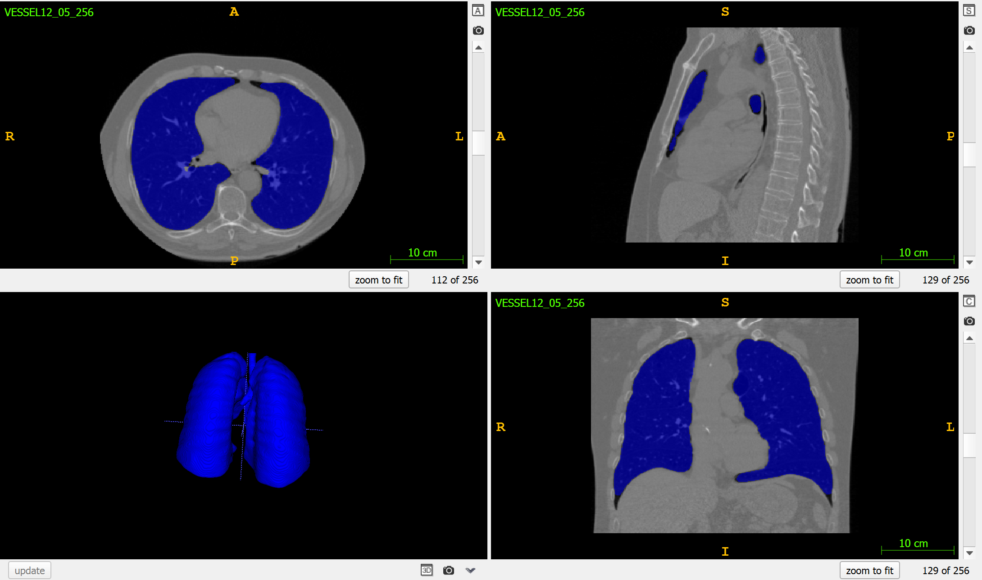
KU Sheet 1
This is how the result of lung segmentation should look like, you can visualize it if you write the segmentation as a binary image (datatype can be uint8 or uint16) and if you open it as a segmentation in ITK-Snap (this overlays the segmentation)
use this button to create 3d rendering of segmentation

